Slide 1

Water Quality Index Prediction

Slide 2
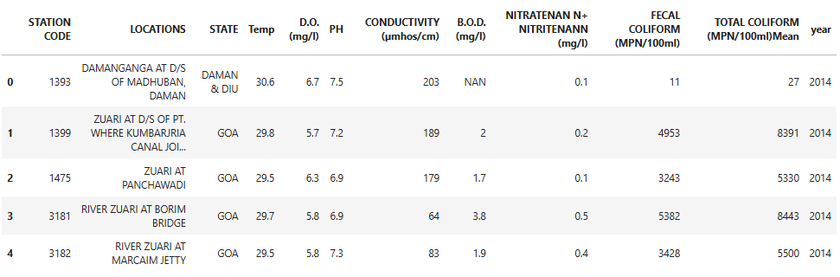
Dataset

Slide 3
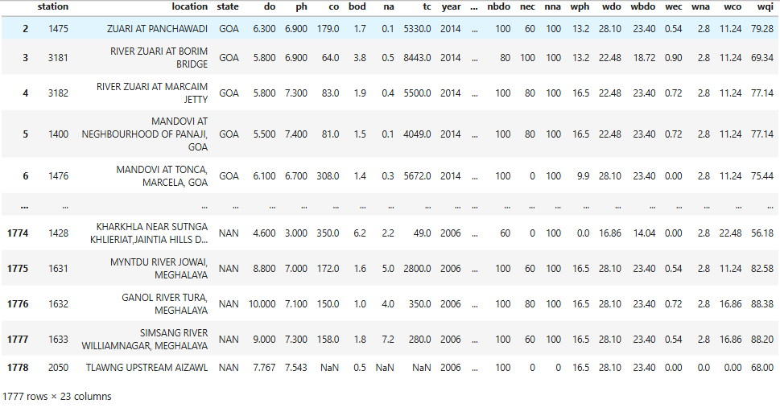
Derived Dataset

Slide 4
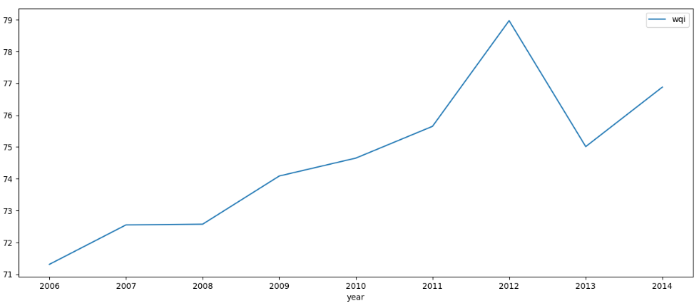
Year-wise WQI

Slide 5
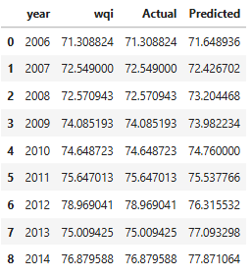
Actual vs Predicted

Slide 6
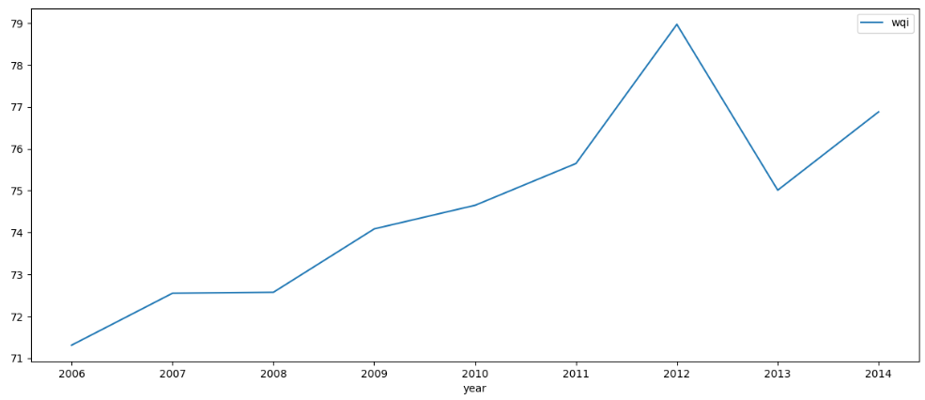
Actual WQI

Slide 7
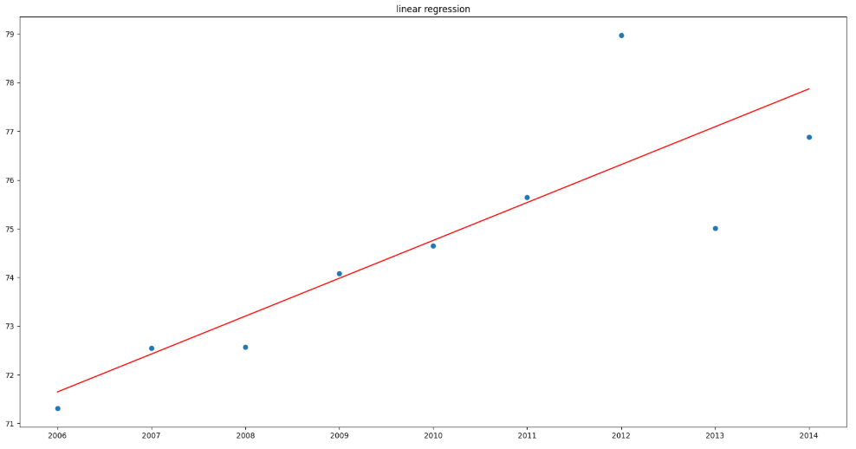
Plot - Actual vs Predicted

